Slide 1
Patch-clamp testing circuit interface
Sdmay18-10 Team Member :
Li Qian Chenhang Xu Daiyuan Ding
Ningyuan Zhang Junhua Hu Yigao Li
Advisor/Client : Professor Que Long
Website: http://sdmay18-10.sd.ece.iastate.edu/

Slide 2
Task responsibility/contributions of Team members
Ningyuan Zhang: Projet Programmer
Draft documents, set up remainder
Daiyuan Ding : Web Engineer
Maintain website, upload documents
Junhua Hu : Project Designer
Design setup, test setup
Chenhang Xu : Communication Leader
Contact with advisor and client
Li Qian : Team Leader
Follow up activities of project and team
Yigao Li : Test Engineer
Test the correctness of setups.

Slide 3
Problem Statement
Patch-clamp is a technology to catch cell with tiny clamp and observe the bioelectricity behavior of the cell. Our project is focusing on how to build up a set of electric environment and circuit to provide operational interface between the patch-clamp and electron microscope with the neurons cells.
We planned to attach an electrode to the membrane of neuron and connect it with appropriate headstage as the input to PC-ONE, and then use oscilloscope connected to PC-ONE to get the output from the current graph.
PC-ONE Patch/Whole Cell Clamp is the main tool we use to build our interface.

Slide 4
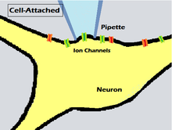
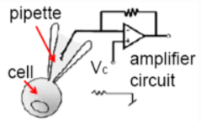
Conceptual Sketch
Basic Structure:
Using glass pipette to capture a cell for characterization of cellular ion channels.
Connect the pipette to the Headstage and the PC-One Whole Cell Patch-Clamp.
Connect the PC-One Whole Cell Patch-Clamp with the Oscilloscope for the measurements.

Slide 5
Functional Requirements
Functional Requirements:
Patch-clamp could catch neuron.
Current could be observed through PC-ONE interface with low noise.
Neuron must be alive during operation.

Slide 6
Non-Functional Requirements
Non-Functional Requirements:
We need to strictly follow the equipment manual to operate all operations to fulfill the project requirements.
We have to strictly follow the safety guide of labolarity to make the experiment process safely.
We have to cite every sources we used during the development, and ensure that the project is totally independent.
Plan regular meeting with client to make sure the project is meeting the requirements.
Timely maintain the project to avoid critical bugs.
Refresh reports and document on time to meet current process.
For ethics rules, we need to follow IEEE ethics code[1].

Slide 7
Market survey
The patch clamp technique is a laboratory technique and it is the gold standard to research the ion channel.
It is the best technique can provide for low-noise measuring of current.
Provides access to the inside of the cell
Allow one to measure current through ion channels VS voltage, time, temperature

Slide 8
Technical Constraints
Only use PC-ONE as our interface instead of other interfaces on the market.
Only focused on the Voltage Clamp method and neuron is the only type of cell we need to observe.
Only use the PC-10 Headstage.

Slide 9
Potential Risks & Mitigation
Technical difficulties.
Lack of background knowledge.
Weak organizational management of team.
Lack of communication with advisor.
We will try our bests to overcome these difficulties with more detailed rules and seek any possible help to solve the problems.

Slide 10
Resources/Cost Estimate
The PC-ONE Whole Cell Patch-Clamp
Oscilloscope
Function Generator
Electrode
There is no other financial resources required for our project expect the neuron we are going to buy. The financial fund is ready.

Slide 11
Project Milestones & Schedule
Test the PC-ONE patch-clamp with several parameters to make sure it works properly.
Set up a prototype of connected patch-clamp with neurons and other necessary equipments
Set up the finished patch-clamp as testing interface(as deliverable)

Slide 12
Overall Design
Use PC-ONE patch-clamp as an interface
Connect PC-ONE and electrode (use headstage)
Use BNC cable to connect PC-ONE and oscilloscope
Set up PC-ONE
Give a voltage to neuron
Get the the current graph on oscilloscope

Slide 13
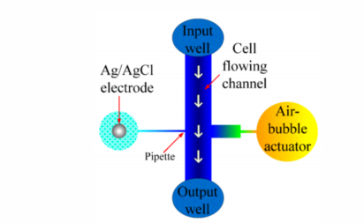
Detailed Design
The proposed patch-clamp chip uses the
Lateral electrodes for trapping cells.
In our design, the electrodes have pipette
size of 3*3 um
The AB actuator is designed for cell selection

Slide 14
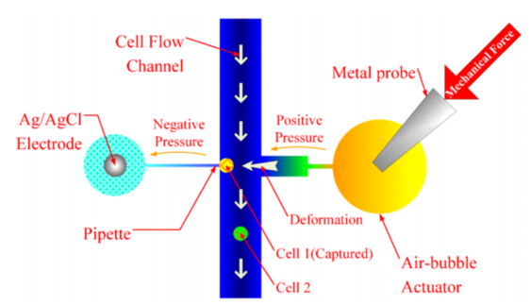
Detailed Design
AB will generate the positive pressure once
the target cell is identified.
A negative pressure will applied to the
Electrode to capture the cell
In this way, the disadvantage of random cell
capture for analysis can be avoided.

Slide 15
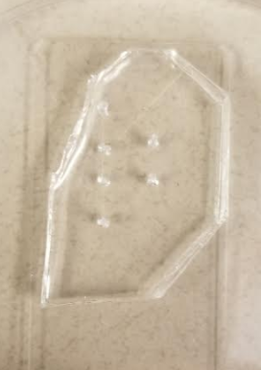
Detailed Design
The left side is the cell flowing channel, we will input
the electrode in two middle holes and use pipette to
catch the cell on the right side.
The advantage for this microchip is we can catch two
cells at the same time.

Slide 16
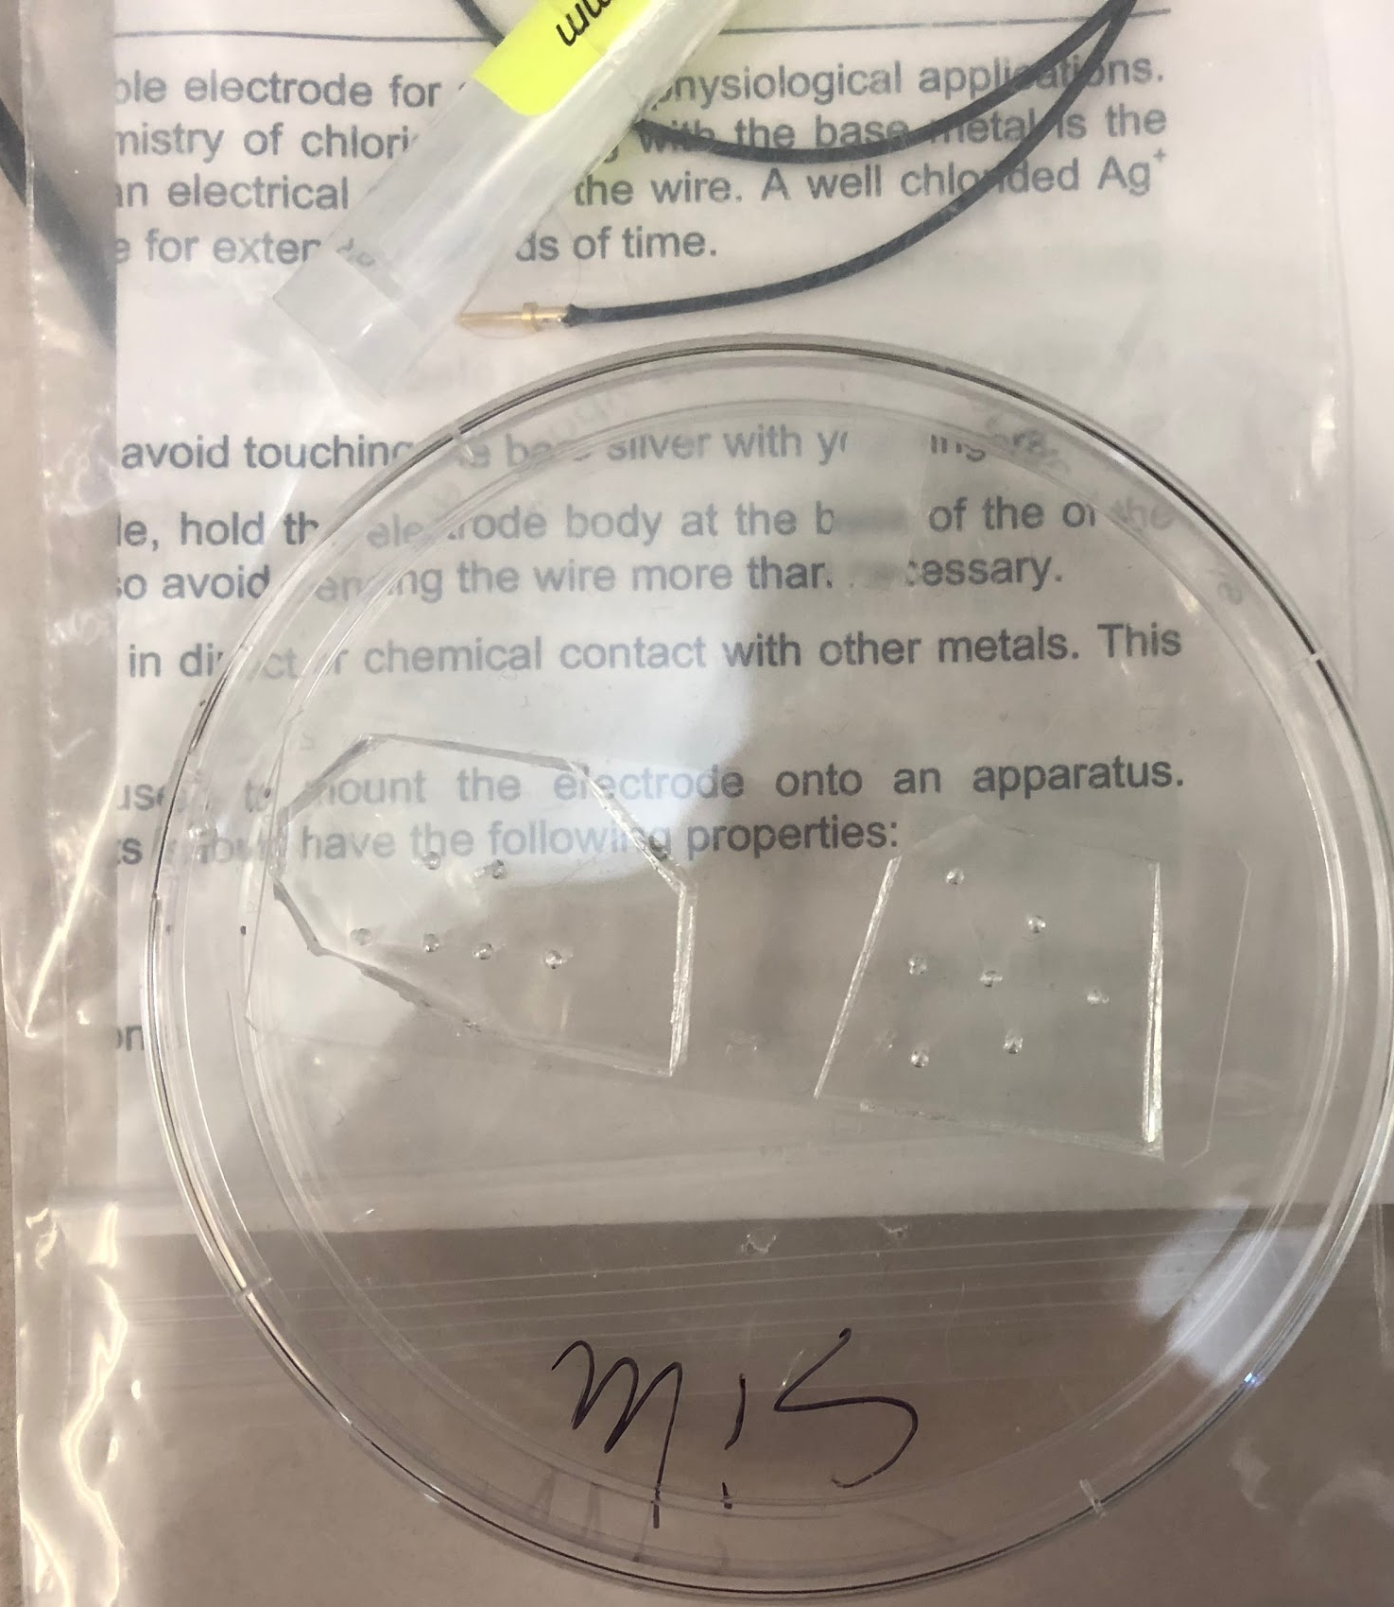
Hardware/Platform
PC-ONE Patch-Clamp
Oscilloscope
Function Generator (Power Supply)
Cell model (micro chip)

Slide 17
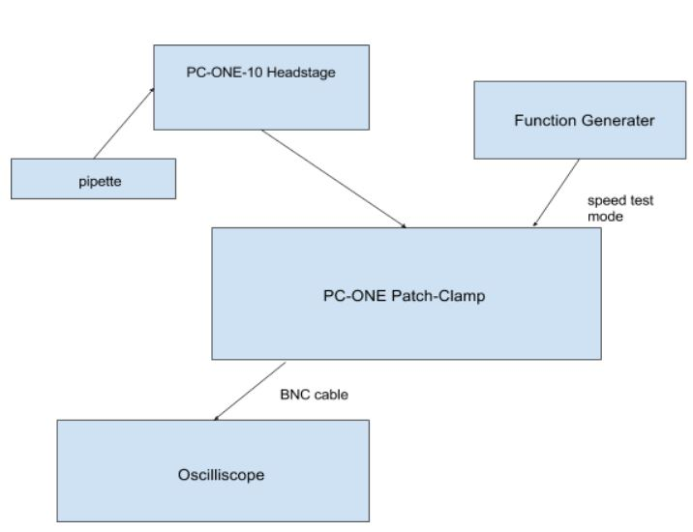
Prototype Implementations

Slide 18
Test Plan
For the First Semester, we planned to finish up the PC-ONE tests without neuron involved. The modes we chose to test are “whole cell” and “speed test”
For the Second Semester, we planned to test the whole interface with the neuron connected and collect test data.

Slide 19
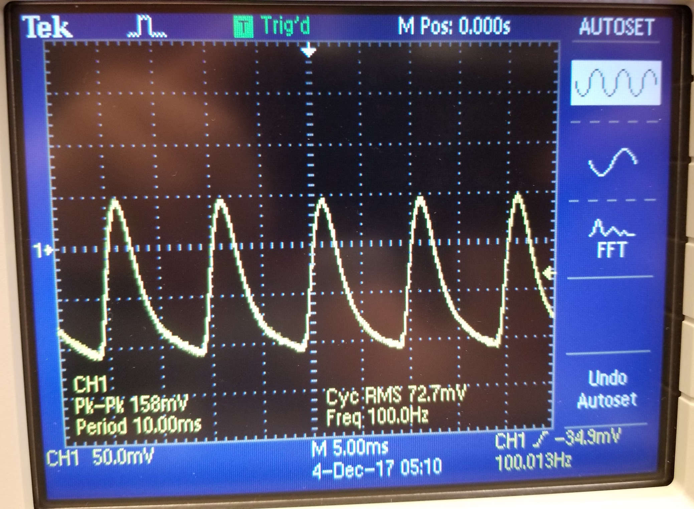
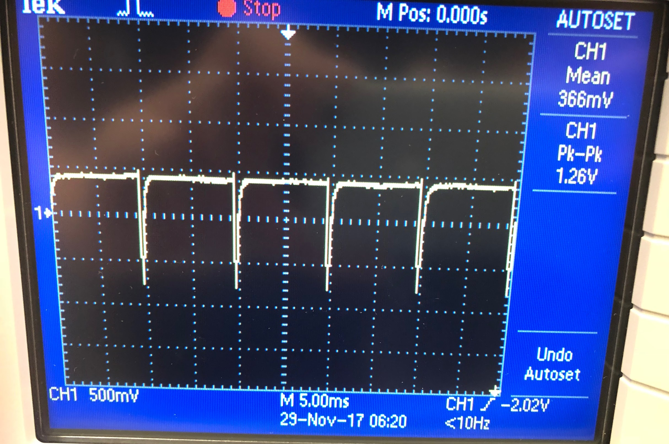
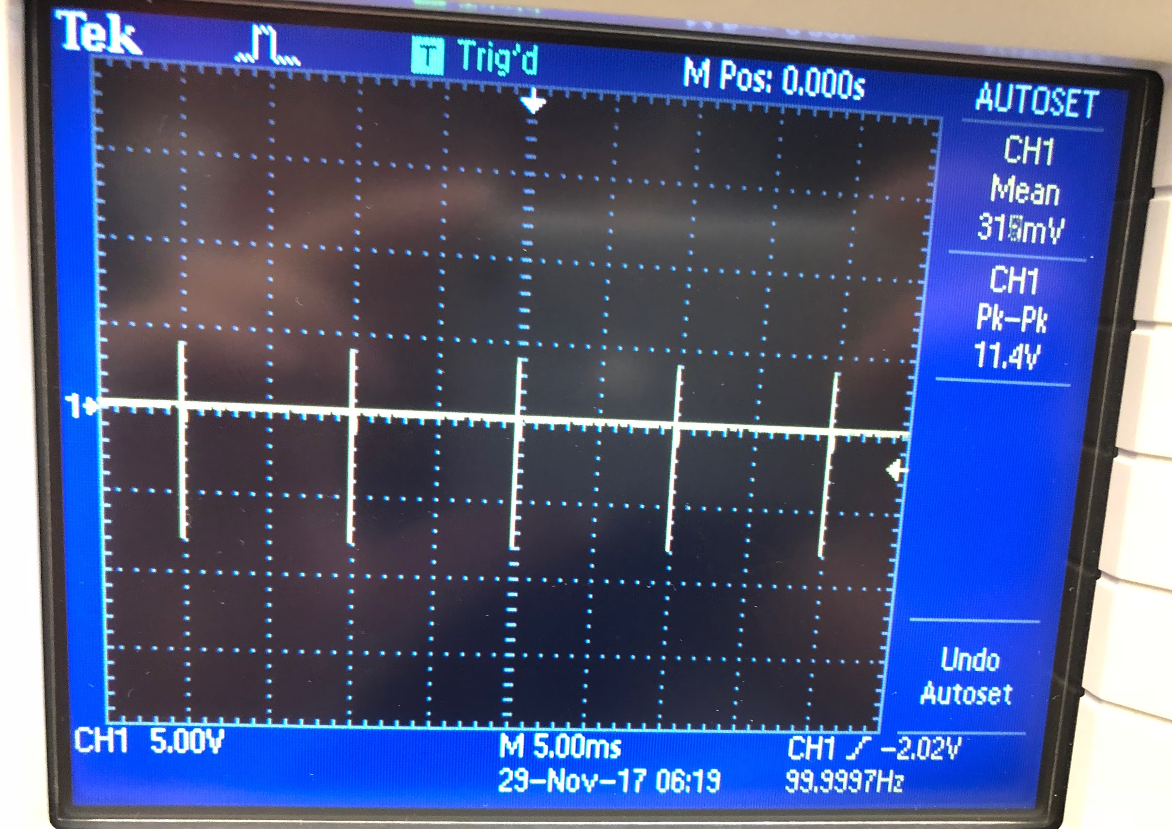
Current status
We have finished up with the whole cell mode test of PC-ONE functionality and the Speed test mode current simulation with prefered data output:

Slide 20
Plan for Next Year
Figure out a method to use PC-10 headstage to run speed test.
Connect the design module and patch-clamp together, running perfectly.
Test the circuit multiple times, and record the results.

Slide 21
Reference
[1]By Winter20jb - I illusrtated this diagram on my computer, CC BY-SA 3.0, https://en.wikipedia.org/w/index.php?curid=44365802
[2]: Zhongcheng Gong, Krithika Nagarajan, Siva Penmetsal, David Millsl, and Long Quel, A patch-clamp device with integrated actuators for cell selection and positioning, Institute for Micromanufacturing, Louisiana Tech University, USA, School of Biological Science, Louisiana Tech University, USA.

